Slide 1
RL- بالعربي
L04: Q-Learning (slides from Berkeley CS188)

Slide 2
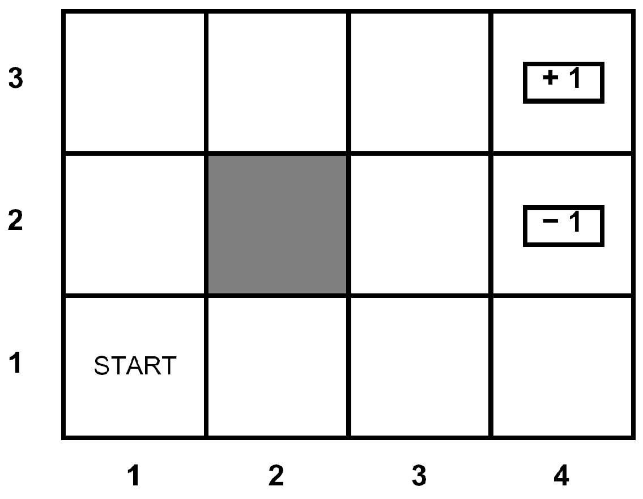
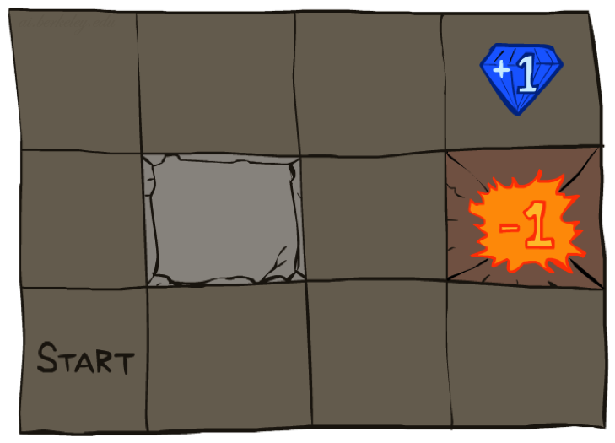




Reinforcement Learning
Still assume a Markov decision process (MDP):
A set of states s ∈ S
A set of actions (per state) A
A model T(s,a,s’)
A reward function R(s,a,s’)
Still looking for a policy π(s)
New twist: don’t know T or R
I.e. we don’t know which states are good or what the actions do
Must actually try actions and states out to learn

Slide 3
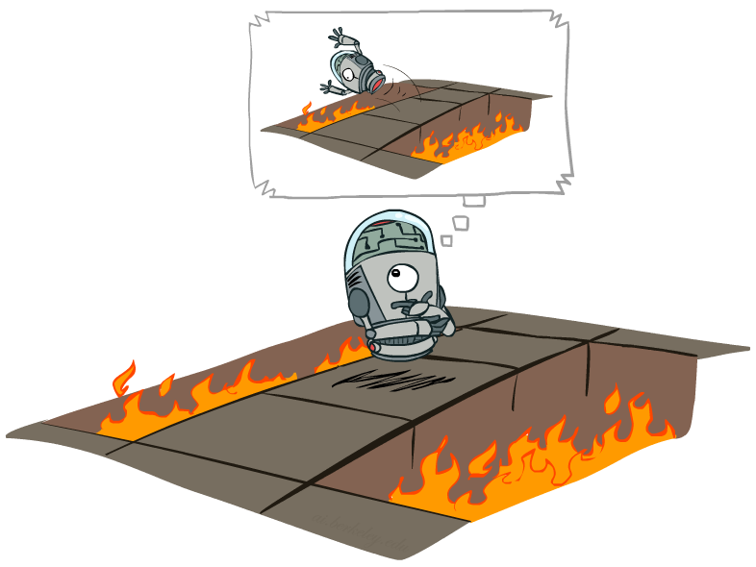
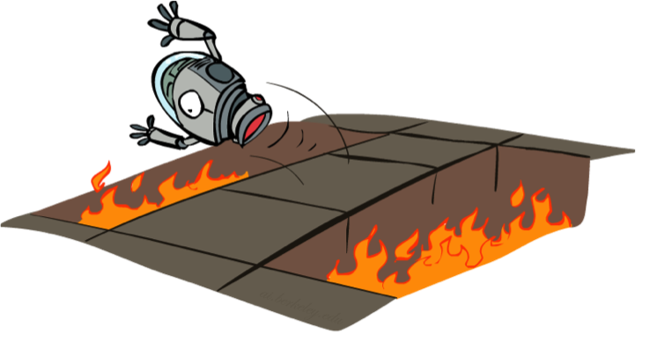
Offline (MDPs) vs. Online (RL)
Offline Solution
Online Learning

Slide 4
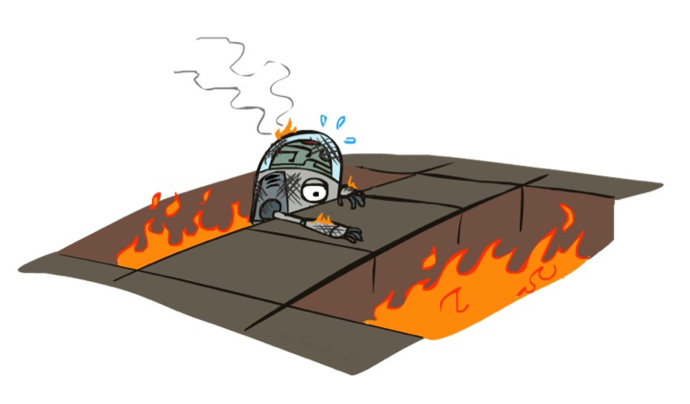
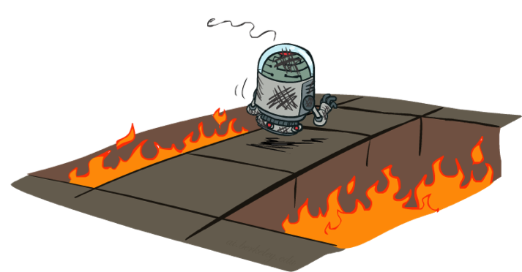
Active Reinforcement Learning

Slide 5
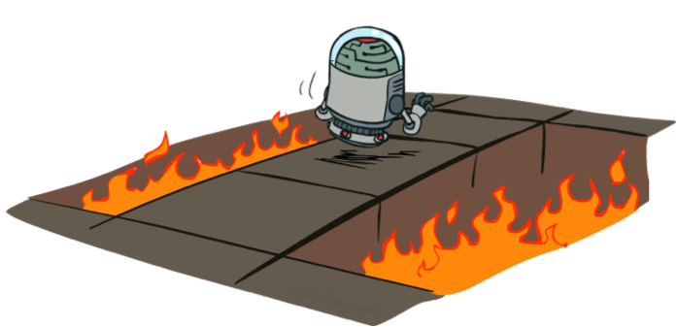
Active Reinforcement Learning
Full reinforcement learning: optimal policies (like value iteration)
You don’t know the transitions T(s,a,s’)
You don’t know the rewards R(s,a,s’)
You choose the actions now
Goal: learn the optimal policy / values
In this case:
Learner makes choices!
Fundamental tradeoff: exploration vs. exploitation
This is NOT offline planning! You actually take actions in the world and find out what happens…

Slide 6
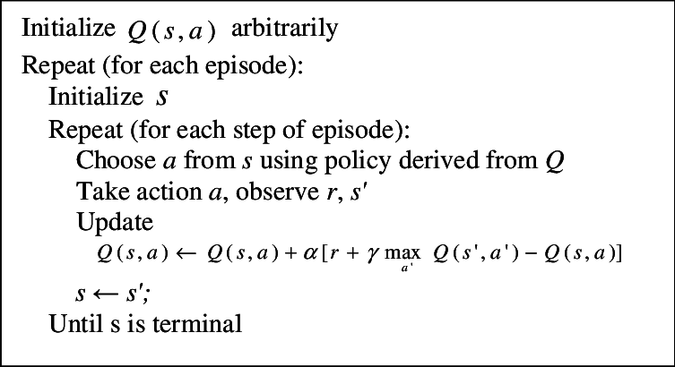
Q-Learning Algorithm
must explore in first episodes
Q(s,a) ← (1 - α) Q(s,a) + α [r + 𝛾 max_{a’} Q(s’,a’)]
learning rate

Slide 7

Q-Learning Properties
Amazing result: Q-learning converges to optimal policy -- even if you’re acting suboptimally!
This is called off-policy learning
Caveats:
You have to explore enough
You have to eventually make the learning rate
small enough

Slide 8
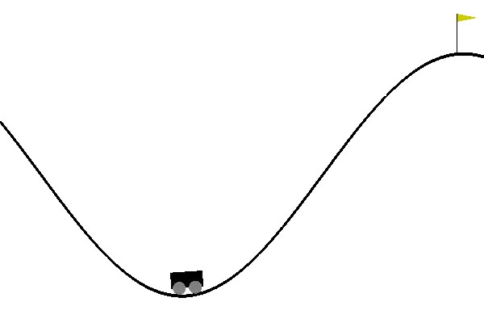
Let’s see a demo
OpenAI: Mountain Car Environment

